Slide 1
Mental Health eScreening
Mental Health Access Clinic Clinician Training
February 25, 2015

Slide 2
Introduction to the eScreening tablet system
Mental Health eScreening Research Pilot
For the last two years, members of the Center for Excellence in Stress and Mental Health (CESAMH) have been using eScreening for OEF/OIF/OND Veterans enrolling in VA Health Care in San Diego. CESAMH has also been tracking OOO Veterans for depression, suicide risk, PTSD, and more.
We (CESAMH) found that about half of the newly enrolled had risk factors for suicide, indicating the need for immediate clinical follow-up. Many of them had symptoms of depression or anxiety, and the majority of these younger Veterans were in physical pain.

Slide 3
Benefits of using eScreening
We have compared screening times between Veterans using paper packet forms versus Veterans using CESAMH tablets to self-assess during enrollment. We found that almost all of the tablet-using Veterans had their screenings documented an average of 19 days sooner than the Veterans who used paper packet forms.
This is a fantastic leap forward in patient care.
We have the cutting edge technology, but without you, we can’t make the process successful. We are asking you to work with us as we roll out a new, upgraded, tablet system with a faster and more user-friendly interface.

Slide 4
The New System
*It’s an upgraded tablet system with a faster and more user-friendly interface.
*We believe we can achieve the same positive results in other clinics while at the same time minimizing the workload that is already required of staff.
Findings from the Research Pilot
eScreening:
was preferred by both Clinicians and Veterans
increased access to mental and physical health screening
allowed for timely triage to appropriate services without increasing staff (approximately 40% of Vets need immediate follow-up with the Suicide Risk Assessment)
created significant improvement in many areas of clinical care
Has far-reaching implications for how technology can streamline screening for mental and physical health needs in healthcare systems.

Slide 5


Training Modules
Today’s Training Covers:
Overview 5 minutes
Setting Up an Assessment 4 minutes
Reporting and Data 1 minute
Troubleshooting & Additional Support 1 minute
User Roles, Permissions, & Security 2 minutes
Dashboard Features 6 minutes
1
2
3
4
5
6

Slide 6
1 | Overview
What is Mental Health eScreening (MHE)?
It’s an electronic assessment system that automates the manual, paper-based process used for initial screening of Veterans in VA healthcare settings.
MHE enables Veterans to complete self-assessments on a tablet or PC while in a clinic.
MHE accelerates patient enrollment by allowing clinicians to oversee the patient-directed screening with real-time scoring, chart note generation, and if pre-determined parameters are exceeded, immediate crisis alerts.
Goals
Facilitate comprehensive mental health screening for newly enrolling Veterans nationwide.
Increase the number of Veterans receiving mental health services.
Improve patient engagement and satisfaction, without an increase in staff and resources.
Gather health data and share with clinicians to improve care delivery to Veterans.

Slide 7
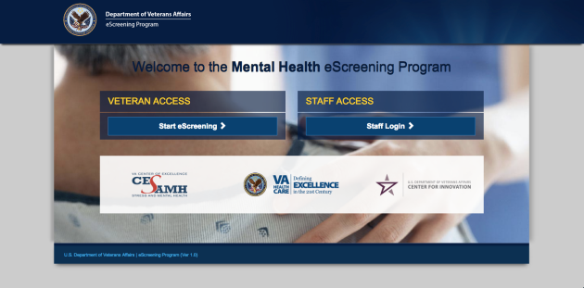
1 | Accessing the application
Access the MHE application with a tablet or a PC, by typing the web address into your browser’s URL field: http://vaww.escreening.va.gov/sd/
The address will be added to the Shared Drive.
The Welcome screen opens:

Slide 8
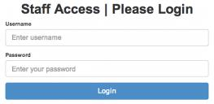

1 | Logging in
Click Staff Login >
The Staff Access | Please Login opens:
2. Type your user name and password, then click Login. Your Home page opens:

Slide 9

1 | Logging out
Click Logout. The system logs you out.
Automatic logout
If you are inactive for 20 minutes, the system will warn that you have 20 seconds before an automatic logout. You must interact with the program if you want to keep your session open. If the system logs you out but you want to keep working, simply log in again.

Slide 10
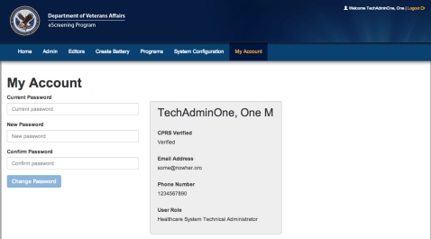
1 | Changing your password
From your Home page, click My Account. The My Account tab opens:
Type your current password.
Type and re-type your new password, then click Change Password. The system updates your password.

Slide 11
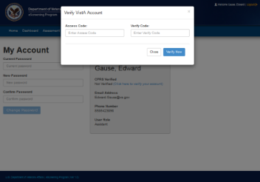
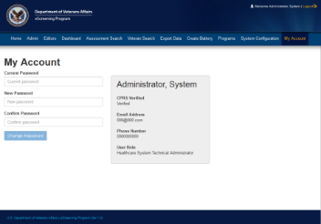
1 | Verifying your CPRS Account
The My Accounts page is also where you verify your CPRS account (one-time only).
Click Click here to verify your account.
Type your Access and Verify Codes.
Click Verify Now.
Log out, then log back in. Your account is verified.

Slide 12


Training Modules
Today’s Training Covers:
Overview 5 minutes
Setting Up an Assessment 4 minutes
Reporting and Data 1 minute
Troubleshooting & Additional Support 1 minute
User Roles, Permissions, & Security 2 minutes
Dashboard Features 6 minutes
1
2
3
4
5
6

Slide 13
2 | User roles and permissions
MHE System Roles
Program Evaluation Administration (CESAMH)
Healthcare System Technical Administrator
Clinician
Assistant
Veteran
Reporting and Metrics
Extracts clinical Battery data from the eScreening database for all sites, to:
identify trends and compare them for program and progress evaluation, and
provide feedback for improvement.
Technical Support
Edits and assigns users;
manages system level settings.
Creates, edits, deletes, & uploads Batteries.
Manages Battery errors.
Completes forms and follow-ups.
Patient Care
Receives clinical data from CPRS.
Utilizes the health data collected through the eScreening application.
Monitors the Battery dashboard with alerts
Medical Support
Creates Batteries for Veterans to complete in the waiting room.
Can access the dashboard to finalize assessment.
The Patient
Completes the Screening Battery.

Slide 14
2 | User Management - Security
Tablets will not function outside of the hospital grounds.
Tablets have built-in tracking capability.
The system records the name and address of the last Veteran who used a missing tablet.
Staff will not be held responsible for tablets which are stolen or broken by a Veteran.

Slide 15


Training Modules
Today’s Training Covers:
Overview 5 minutes
Setting Up an Assessment 4 minutes
Reporting and Data 1 minute
Troubleshooting & Additional Support 1 minute
User Roles, Permissions, & Security 2 minutes
Dashboard Features 6 minutes
1
2
3
4
5
6

Slide 16
3 | Setting Up Assessments
Assessments may be created in a batch for the next day’s appointments, or they may be created singly for a walk-in Veteran.
Before a Veteran can begin eScreening, one of these users must set up an assessment for the Veteran:
Healthcare System Technical Administrator,
Clinician (LVNs, RNs, NPs, MDs, etc.), or
Assistant (MSA, etc.).
Setting up an assessment consists of these procedures done in sequence:
Create a Veteran record (or locate one) in the database (DB).
Assign a new battery to the Veteran.
After A and B are complete, the system is ready to accept input on a tablet from the Veteran.

Slide 17
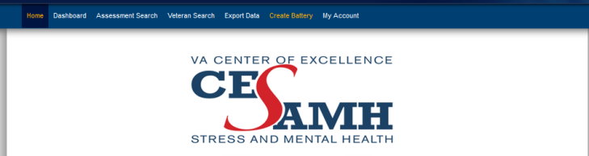
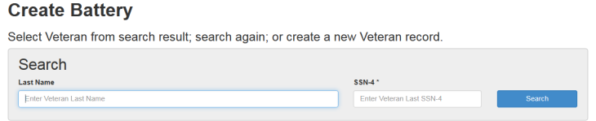
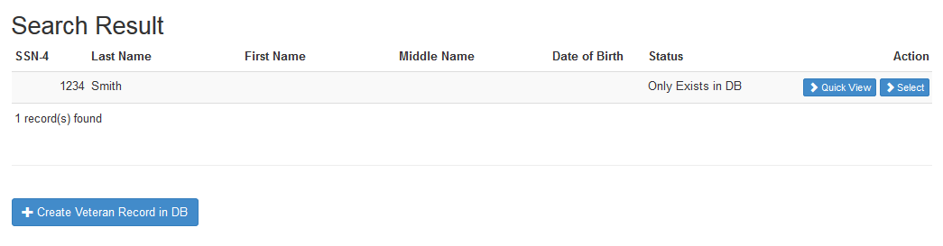
3 | Setting Up an Assessment
Searching for a Veteran
From the Home page, click Create Battery.
Type Last Name and SSN-4, then click Search.
Click Select by the name of the Veteran you want to create the assessment for.

Slide 18
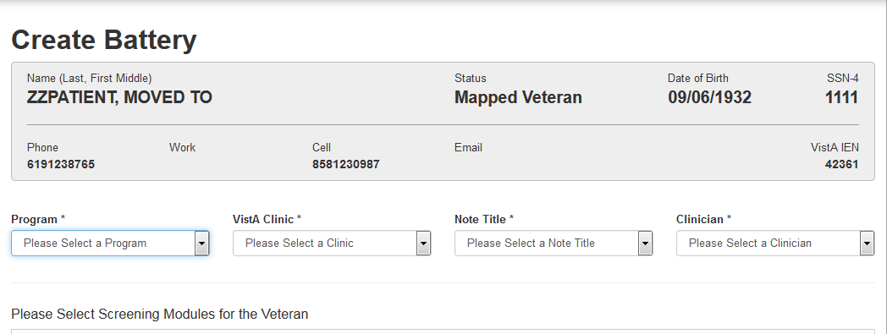
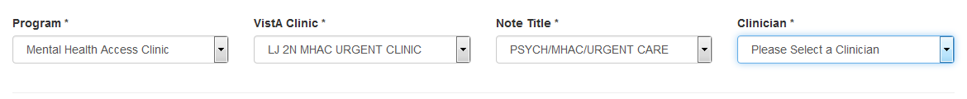

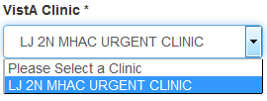
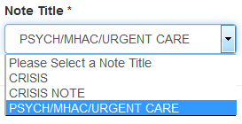
3 | Setting Up an Assessment
Creating the Assessment
Click Create New Battery.
Select the following drop-downs.
Scroll down and select Mental Health, then scroll down and click Save.

Slide 19
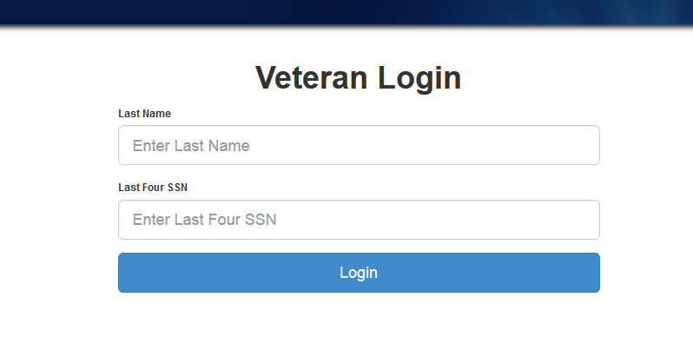
3 | Setting Up an Assessment
The system is ready for the Veteran to log in and complete the Battery.

Slide 20

Training Modules
Today’s Training Covers:
Overview 5 minutes
Setting Up an Assessment 4 minutes
Reporting and Data 1 minute
Troubleshooting & Additional Support 1 minute
User Roles, Permissions, & Security 2 minutes
Dashboard Features 6 minutes
1
2
3
4
5
6

Slide 21
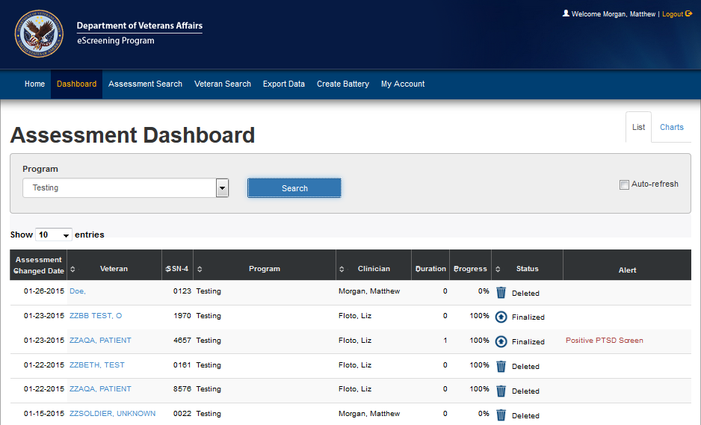
4 | Dashboard Features
From the Home screen, click Dashboard.
The Dashboard opens in List view. This view shows the Veterans who have a battery scheduled, in progress, or completed, and any alerts associated with the screenings.

Slide 22
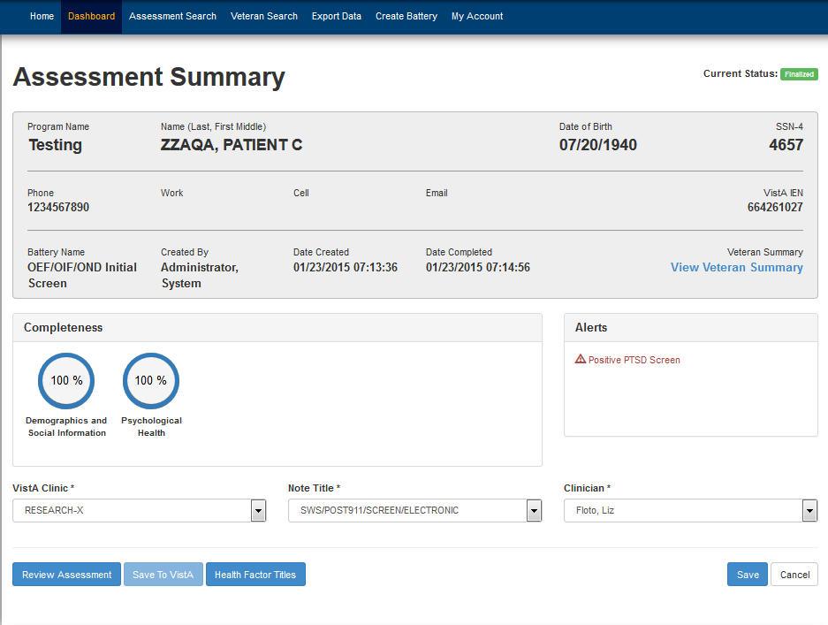
4 | Dashboard Features
Clicking a Veteran’s name brings you to the Assessment Summary page. You can click Review Assessment to review the CPRS note.

Slide 23
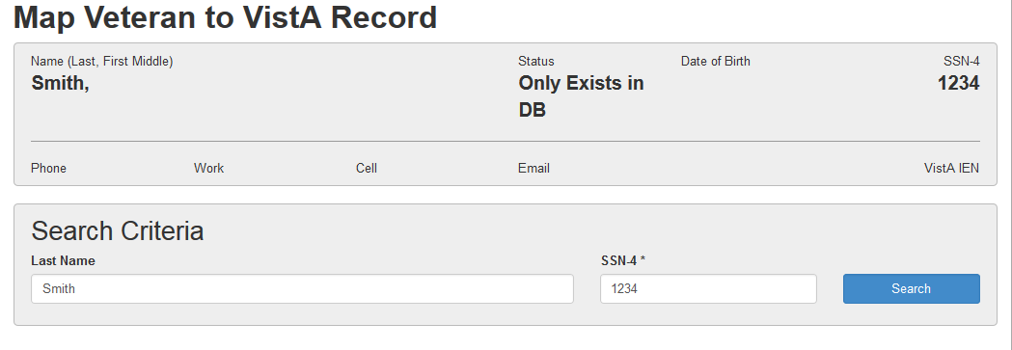
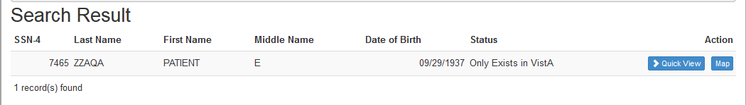
4 | Dashboard Features
Mapping a Veteran to a VistA Record
After the Veteran is finished with the assessment, click Map to Vista Record.
Click Search, then click Map.

Slide 24


4 | Dashboard Features
Assessment Summary
The Assessment Summary has many functions:
Review the CPRS Note
View the Veteran Summary
Save to VistA

Slide 25

Training Modules
Today’s Training Covers:
Overview 5 minutes
Setting Up an Assessment 4 minutes
Reporting and Data 1 minute
Troubleshooting & Additional Support 1 minute
User Roles, Permissions, & Security 2 minutes
Dashboard Features 6 minutes
1
2
3
4
5
6

Slide 26
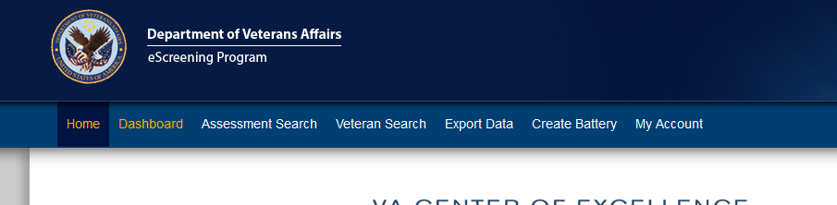
5| Reporting and Data
Introduction to Reporting and Data
MHE incorporates a number of functions that allow you to view Veteran and assessment data, and generate various reports.
You can:
Search the system for Veterans and Assessments.
Print or review a Veteran’s individual questions and answers.
Export data for program evaluation.

Slide 27

Training Modules
Today’s Training Covers:
Overview 5 minutes
Setting Up an Assessment 4 minutes
Reporting and Data 1 minute
Troubleshooting & Additional Support 1 minute
User Roles, Permissions, & Security 2 minutes
Dashboard Features 6 minutes
1
2
3
4
5
6

Slide 28
6| Troubleshooting & Support
Additional Training
Supplemental and future trainings options:
Future refresher training, as needed
Review the User Training Manual
Contact your training resources:
Liz Floto
858-552-8585 Ext. 5550
Elizabeth.floto@va.gov
Matthew Morgan 858-552-8585 ext.5557
Matthew.Morgan@va.gov

Slide 29
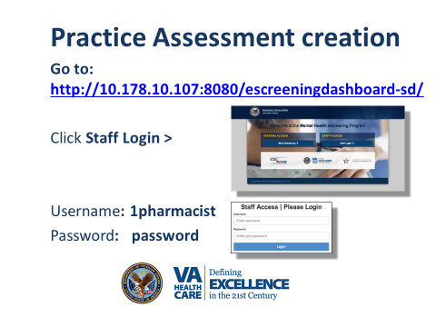

Slide 30
Process flow at the Mental Health Access Clinic
Veteran Task
Existing AMSA Task
Existing Clinic Manager Task
New AMSA Task
New Clinic Manager Task
Provider Task
AMSA asks Veteran to take eScreen
If no, eScreening ends
AMSA exchanges tablet for Veteran’s ID
Veteran takes eScreen
AMSA checks in Veteran
If yes, AMSA sets up assessment
AMSA returns Veteran’s ID and receives tablet
AMSA disinfects tablet and returns it to the cabinet
CM/ Nurse reviews responses
AMSA/ Nurse pushes data to CPRS
AMSA/ Nurse gives Veteran the Veteran Summary printout
Veteran Returns to waiting room
CM orders labs if needed and signs note in CPRS
Provider calls Veteran from waiting room
Provider completes health care appointment
MSA checks out Veteran and offers/ schedules follow up visit
eScreening ends and Veteran leaves

Slide 31
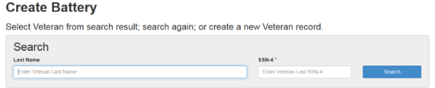
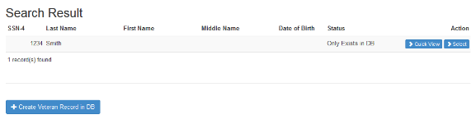
3 | Setting Up an Assessment
Searching for a Veteran
From your Home page, click Create Battery. The Create Battery page opens.
Type Last Name and SSN-4, then click Search.
Click Select by the name of the Veteran you want to work with.

Slide 32




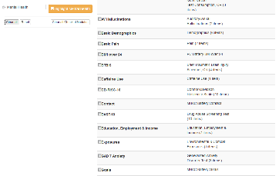
Setting Up an Assessment
Creating the Assessment
Click Create New Battery.
Select the drop-downs illustrated below.
Scroll down and click Mental Health, then scroll down and click Save.

Slide 33
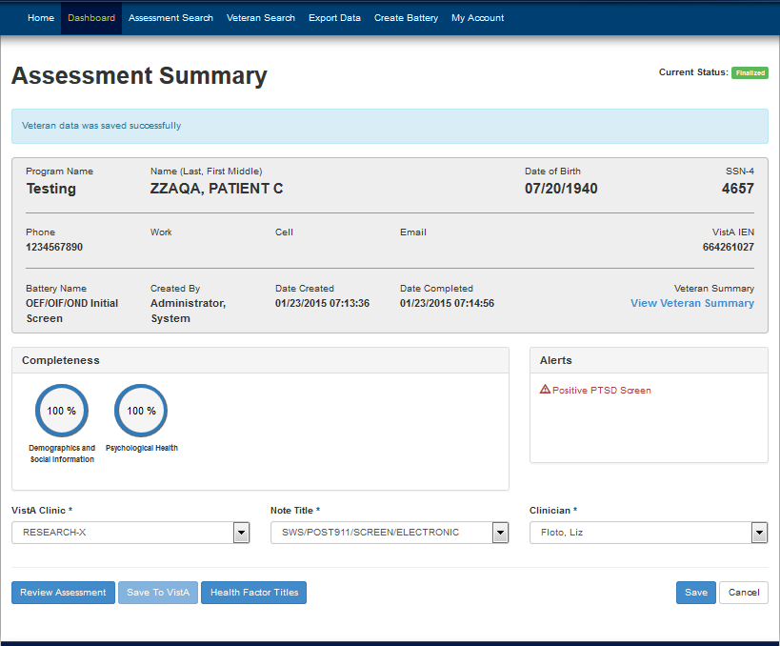
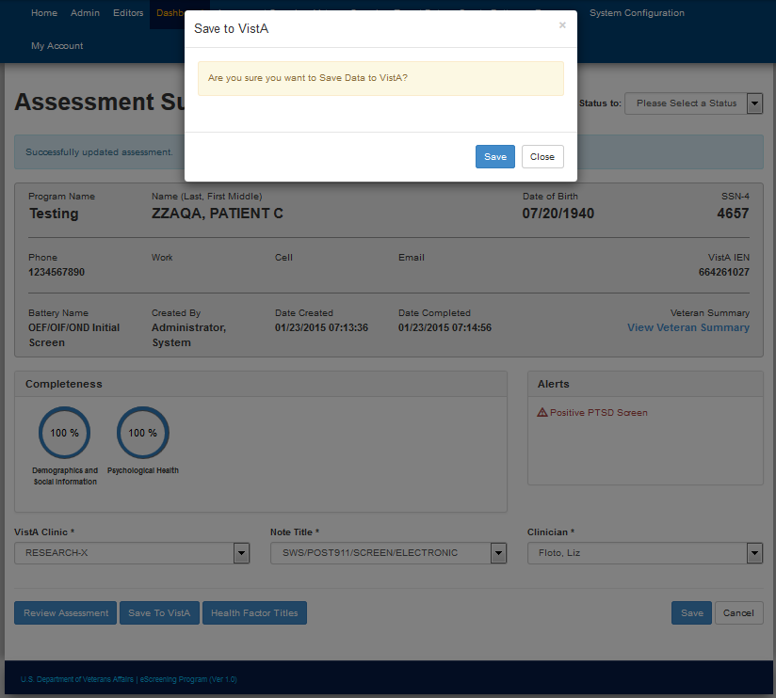
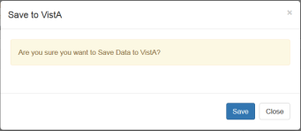

Using CPRS with eScreening
A. Saving eScreening Data to VistA
Click Dashboard … Select Veteran
Click Save to Vista.
Click Save. Veteran data is saved to VistA.

Slide 34

Process flow for the Mental Health Access Clinic
Veteran Task
Existing AMSA Task
Existing Clinic Manager Task
New AMSA Task
New Clinic Manager Task
Provider Task
AMSA asks Veteran to take eScreen
If no, eScreening ends
AMSA exchanges tablet for Veteran’s ID
Veteran takes eScreen
AMSA checks in Veteran
If yes, AMSA sets up assessment
AMSA returns Veteran’s ID and receives tablet
AMSA disinfects tablet and returns it to the cabinet
CM/ Nurse reviews responses
AMSA/ Nurse pushes data to CPRS
AMSA/ Nurse gives Veteran the Veteran Summary printout
Veteran Returns to waiting room
CM orders labs if needed and signs note in CPRS
Provider calls Veteran from waiting room
Provider completes health care appointment
MSA checks out Veteran and offers/ schedules follow up visit
eScreening ends and Veteran leaves

Slide 35
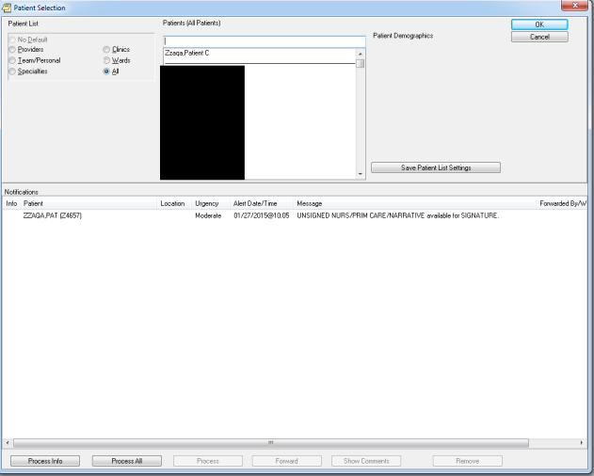
Using CPRS with eScreening
B. Alerting
After the information is sent to CPRS/VistA, a notification is generated.

Slide 36
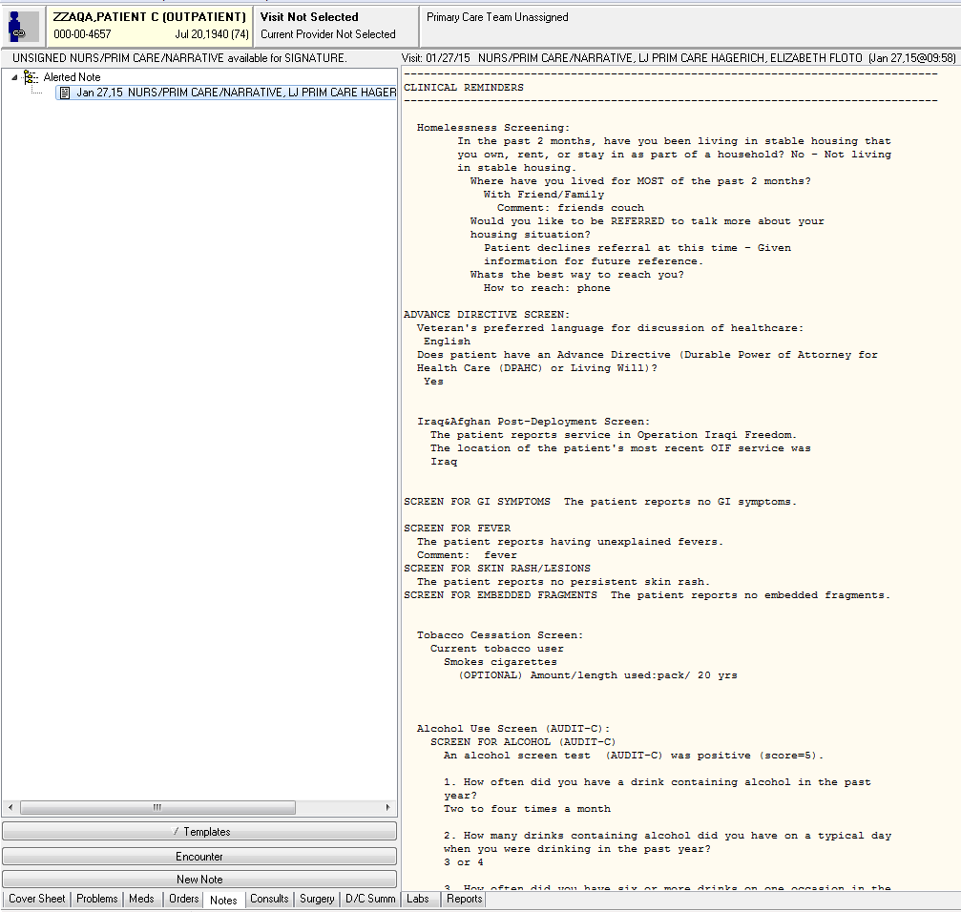
Using CPRS with eScreening
C. CPRS Note
MHE will begin your Note, and auto-populate the information the Veteran entered on the Tablet—Including Clinical Reminders.

Slide 37
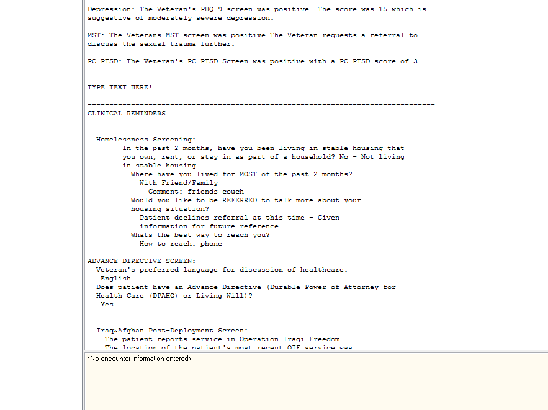
Using CPRS with eScreening
D. Editing the Note
Click Edit Note to add additional information to the note.

Slide 38
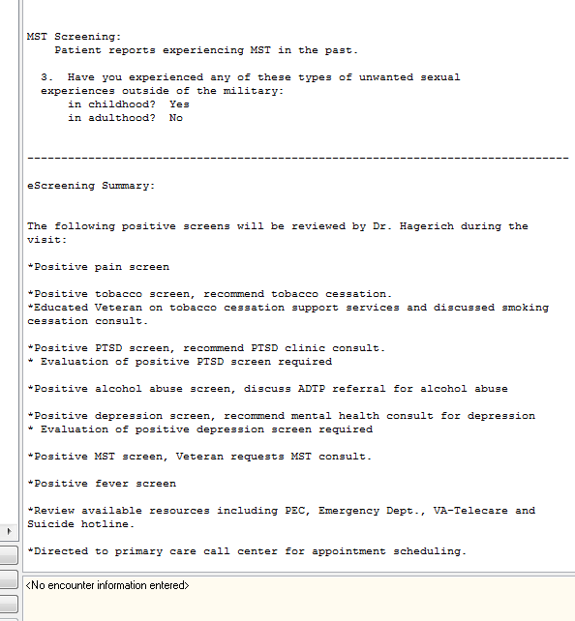
Using CPRS with eScreening
E. Footer
Any positive screens will be summarized in the bottom of the note for the Provider to attend to during the visit. You can add the Provider as a Cosigner as necessary.

Slide 39

Process flow for the Mental Health Access Clinic
Veteran Task
Existing AMSA Task
Existing Clinic Manager Task
New AMSA Task
New Clinic Manager Task
Provider Task
AMSA asks Veteran to take eScreen
If no, eScreening ends
AMSA exchanges tablet for Veteran’s ID
Veteran takes eScreen
AMSA checks in Veteran
If yes, AMSA sets up assessment
AMSA returns Veteran’s ID and receives tablet
AMSA disinfects tablet and returns it to the cabinet
CM/ Nurse reviews responses
AMSA/ Nurse pushes data to CPRS
AMSA/ Nurse gives Veteran the Veteran Summary printout
Veteran Returns to waiting room
CM orders labs if needed and signs note in CPRS
Provider calls Veteran from waiting room
Provider completes health care appointment
MSA checks out Veteran and offers/ schedules follow up visit
eScreening ends and Veteran leaves

Slide 40
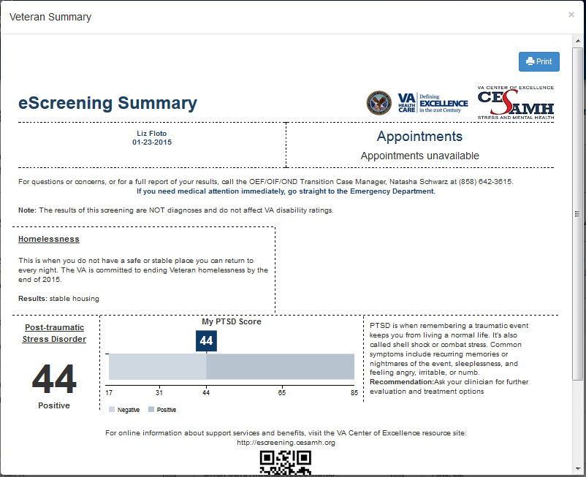
View & Print the Veteran Summary

Slide 41
Questions?

Slide 42
Thank you for attending the training!

